Slide 1
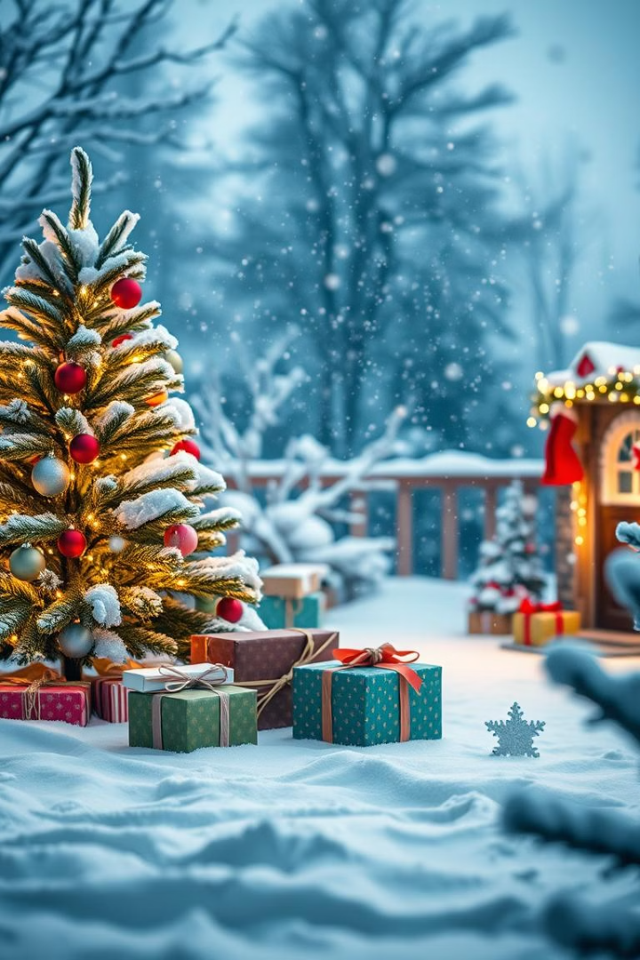
Christmas Around the World: UK vs. USA
Get ready for a fun journey as we explore Christmas traditions in the UK and the USA!
by Pavel Koc and GAMMA.APP

Slide 2
Christmas Vocabulary
Santa Claus
Sleigh
Reindeer
Snowman
The jolly man who brings presents to good children on Christmas Eve.
Santa's magical vehicle pulled by reindeer.
The flying deer that help Santa deliver presents.
A fun winter friend made from snow.

Slide 3
Christmas Similarities
Santa Claus
Gift-Giving
Both countries believe in Santa Claus bringing presents!
Giving gifts to loved ones is a big part of the holiday.
Home Decorations
Christmas Carols
Singing Christmas carols fills the air with cheer.
People love to decorate their homes with lights and trees.

Slide 4
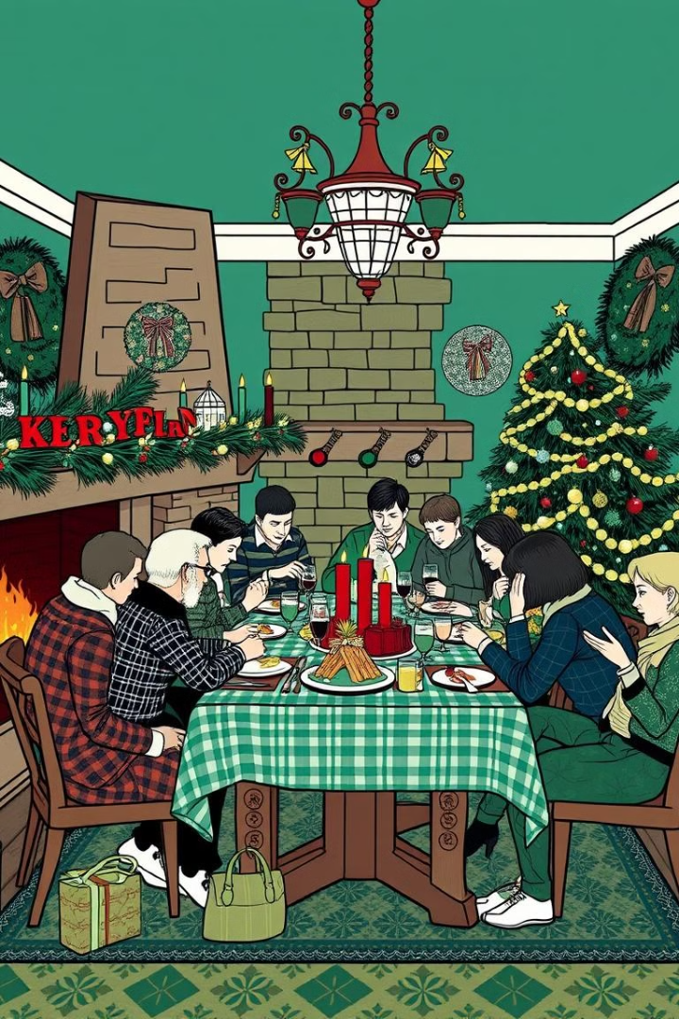
Christmas Traditions in the UK
1
Boxing Day
The day after Christmas, a time for family and friends to relax and enjoy each other's company.
2
Christmas Pudding
This rich, dark fruitcake is a traditional Christmas dessert in the UK, made with brandy and spices.
3
Pantomime
A fun, interactive theatrical performance, often based on classic fairy tales.

Slide 5
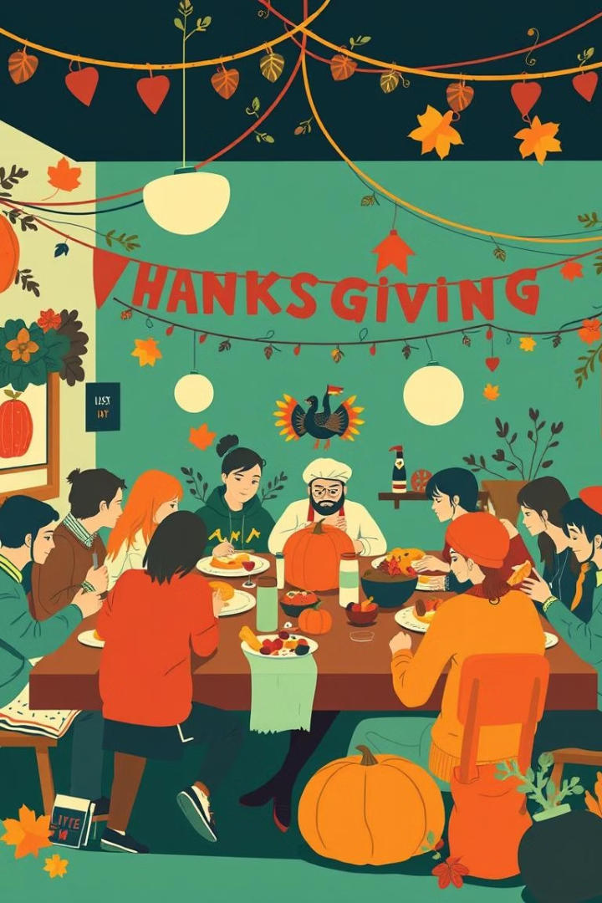
Christmas Traditions in the USA
1
Thanksgiving
A holiday celebrated in November, a time to be thankful for family and friends, featuring a large turkey dinner.
2
Black Friday
The day after Thanksgiving, known for its huge sales and shopping deals.
3
Christmas Eve
Many families attend church services or celebrate with a special meal.

